Slide 1

Codebasics SQL Challenge
Ad Hoc Request

Slide 2
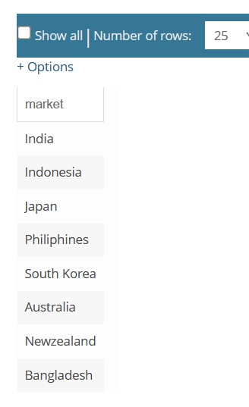
Markets
India
Indonesia
Japan
Philiphines
South Korea
Australia
Newzealand
Bangladesh
Question 1
Provide the list of markets in which customer "Atliq Exclusive" operates its business in the APAC region.

Slide 3
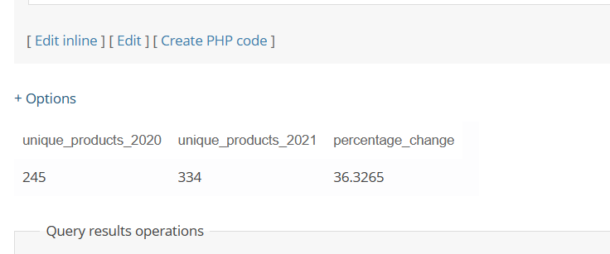
Question 2
What is the percentage of unique product increase in 2021 vs. 2020? The final output contains these fields, unique_products_2020 unique_products_2021 percentage_chg

Slide 4
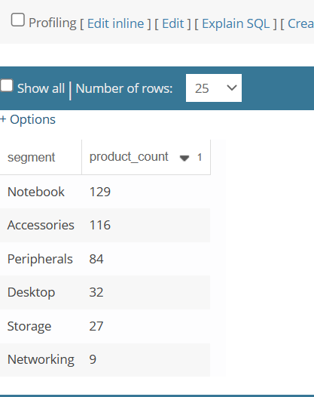
Question 3
Provide a report with all the unique product counts for each segment and sort them in descending order of product counts. The final output contains 2 fields, segment product_count

Slide 5
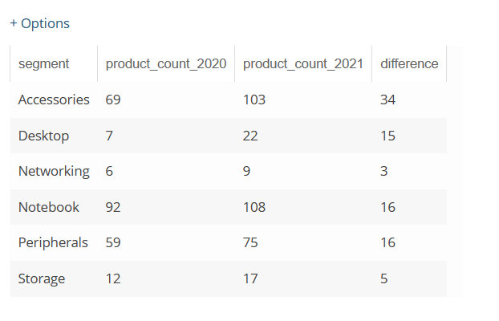
Question 4
Follow-up: Which segment had the most increase in unique products in 2021 vs 2020? The final output contains these fields, segment product_count_2020 product_count_2021 difference

Slide 6
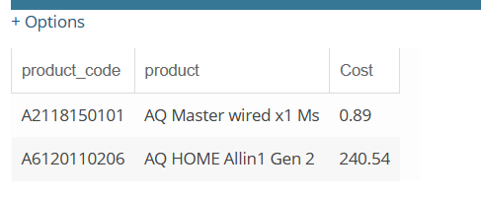
Question 5
Get the products that have the highest and lowest manufacturing costs. The final output should contain these fields, product_code product manufacturing_cost

Slide 7
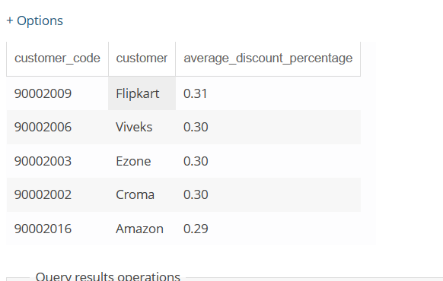
Question 6
Generate a report which contains the top 5 customers who received an average high pre_invoice_discount_pct for the fiscal year 2021 and in the Indian market. The final output contains these fields, customer_code customer average_discount_percentage

Slide 8
month | year | Gross sales Amount
10 | 2019 | 5135902
11 | 2019 | 7522893
12 | 2019 | 4830405
9 | 2019 | 4496260
9 | 2020 | 12353510
12 | 2020 | 12944660
11 | 2020 | 20464999
10 | 2020 | 13218636
8 | 2020 | 2786648
7 | 2020 | 2551159
6 | 2020 | 1695217
5 | 2020 | 783813.4
4 | 2020 | 395035.4
3 | 2020 | 378771
2 | 2020 | 3996228
1 | 2020 | 4740600
1 | 2021 | 12399393
2 | 2021 | 10129736
3 | 2021 | 12144061
4 | 2021 | 7312000
5 | 2021 | 12150225
6 | 2021 | 9824521
7 | 2021 | 12092346
8 | 2021 | 7178708
Question 7
Get the complete report of the Gross sales amount for the customer “Atliq Exclusive” for each month . This analysis helps to get an idea of low and high-performing months and take strategic decisions.
The final report contains these columns: Month Year Gross sales Amount

Slide 9
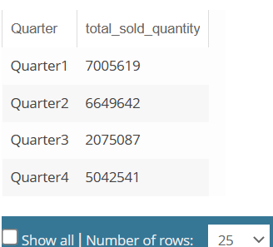
Question 8
In which quarter of 2020, got the maximum total_sold_quantity? The final output contains these fields sorted by the total_sold_quantity,
Quarter total_sold_quantity

Slide 10
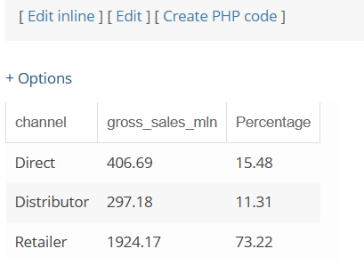
Question 9
Which channel helped to bring more gross sales in the fiscal year 2021 and the percentage of contribution? The final output contains these fields,
channel gross_sales_mln percentage

Slide 11
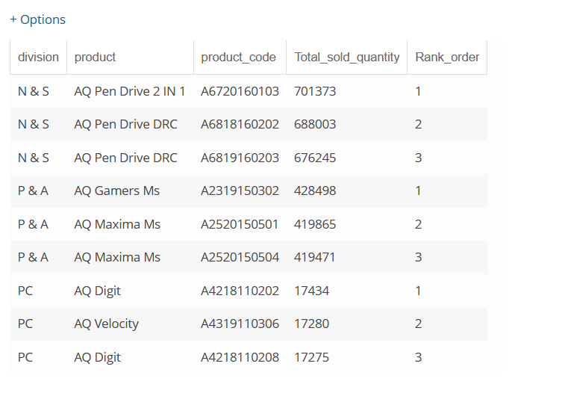
Question 10
Get the Top 3 products in each division that have a high total_sold_quantity in the fiscal_year 2021? The final output contains these fields,
division product_code product total_sold_quantity rank_order

Slide 12
Thanks 🙂
- Kannan N

